Slide 1
Web Programming Language
Week 13
React 4

Slide 2
React-Router
So far the apps have been “Single Page Apps” (SPA)
React can also be used to create full websites

Slide 3
React-router-dom
Install React Router in a new project
npm i -D react-router-dom
Import it into index.js
import { BrowserRouter as Router, Route } from 'react-router-dom';

Slide 4
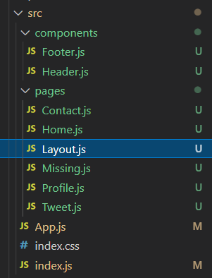
Pages
Different pages are components
Most of these can initially be basic components, but in time they can add different parts of the site

Slide 5
index.js
import React from 'react’; import ReactDOM from 'react-dom/client’; import './index.css’; import App from './App’; import Header from './components/Header’; import Footer from './components/Footer’ const root = ReactDOM.createRoot(document.getElementById('root’)); root.render( <React.StrictMode> <Header /> <App /> <Footer /> </React.StrictMode> );

Slide 6
App.js
Import React Router
import { BrowserRouter, Routes, Route } from "react-router-dom"; import Contact from './pages/Contact’; import Home from './pages/Home’; import Missing from './pages/Missing’; import Profile from './pages/Profile’; import Tweet from './pages/Tweet’; import Layout from './pages/Layout’; function App() { return ( <BrowserRouter> <Routes> <Route path="/" element={<Layout />}> <Route index element={<Home />} /> <Route path="contact" element={<Contact />} /> <Route path="profile" element={<Profile />} /> <Route path="tweet" element={<Tweet />} /> <Route path="*" element={<Missing />} /> </Route> </Routes> </BrowserRouter> ); }
Import Pages
Set Paths for Routes

Slide 7
Layout.js
import { Outlet, Link } from "react-router-dom"; const Layout = () => { return ( <> <nav> <ul> <li> <Link to="/">Home</Link> </li> <li> <Link to="/profile">Profile</Link> </li> <li> <Link to="/contact">Contact</Link> </li> <li> <Link to="/tweet">Tweet</Link> </li> </ul> </nav> <Outlet /> </> ) }; export default Layout;
Contains 2 parts,
A navigation panel
An Outlet to display each page
Link is used in place of <a href=
For internal paths
Keeps track of browsing history
<> </> is a fragment

Slide 8
Missing.js
Path was set as;
<Route path="*" element={<Missing />} />
This traps any broken links and directs them to a 404 page for example

Slide 9
Summary
React Router can be used to create multipage sites
It handles the routes of different paths directing them to display different components

